Slide 1


Presentation in Purdue University
2015-11-05
Chenggang Wu
State Key Laboratory of Computer Architecture
Institute of Computing Technology, Chinese Academy of Sciences

Slide 2


ICT
Institute of Computing Technology, Chinese Academy of Sciences

Slide 3
ICT
Computer Architecture
Network
Artificial intelligence

Slide 4

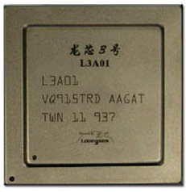
My Research Interests
Dynamic Compilation
DigitalBridge (BT system)
Serve for Loongson processors
Binary Translation
& Dynamic Optimization
Software Testing
& Bug Detection
ASLR, CFI, Obfuscation,
Code Diversity
Software Security

Slide 5
Using Local Clocks to Reproduce
Concurrency Bugs
Zhe Wang, Chenggang Wu, Xiang Yuan, Zhenjiang Wang, Jianjun Li, Pen-Chung Yew, Jeff Huang, Xiaobing Feng, Yanyan Lan, Yunji Chen and Yong Guan
State Key Laboratory of Computer Architecture, Institute of Computing Technology Chinese Academy of Sciences
Published in IEEE Transactions on Software Engineering (TSE 2017)

Slide 6
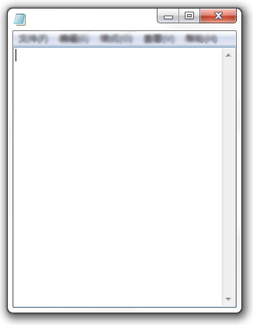

Background
Fully utilize the computing power of multi-core processors
parallel programming
Concurrent programs are difficult to test and debug
their non-determinism execution
Some bugs may escape from testing……
Notes:
Multi-core processor has become the main architecture of modern CPUs. To explore the computing power of such processors, more and more programmers have to write parallel programs.
However, it is not an easy job. Because of the non-determinism of parallel programs, testing or debugging such a program is very difficult. From our experience, a bug triggers an error one time in 100 runs. When we debug the program, no error occurs. The main reason is that the error run have a special and rare interleaving.
And this feature may make some bugs escape from testing.

Slide 7
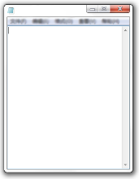



Therac-25 medical accident
2003 North American blackout
Take about 73 days to fix one concurrency bug [Lu et al. 2008]
Notes:
During most cases in production run, the escaped bugs may not be trigger in most times.
However in rare cases, the bug meets its special interleaving and is triggered. It may cause serious accident.
Such as XXX,XXXX
Because of the non-deterministic, these bugs are hard to debug.
A survey shows that XXXX.

Slide 8
A useful way to fix such bugs: bug reproduction
Record Phase
Replay Phase
Logs
1
1
1
2
2
3
5
2
3
5
6
5
4
4
6
7
8
9
6
7
8
9
Record all shared memory accesses:
huge performance penalty
10X ~ 100X
Tradeoff between:
Online recording overhead & Offline analysis overhead
Notes:
Many efforts try to solve the problem, such as bug testing, bug detection, bug reproduction, bug location, bug tolerance, etc.
Among these methods, bug reproduction is the most useful way. It can be divided into 2 phases.
one is recording phase, it records part or whole order information during execution. When an error occurs, bug reproduction system enter the second phase. It tries to infer the buggy interleaving with the recorded information and replay the execution.
A simple way to reproducing these bugs is to record the whole order of all shared memory accesses.
But it will introduce huge runtime overhead, about 10X ~ 100X.
Then, researches have to reduce recorded information, and make a tradeoff between the recording overhead and analysis overhead.

Slide 9
Two representative systems:
PRES [Park et al, 2009]
records global orders of some events:
sync, syscall, function, basic block, memory instruction
searches buggy interleaving by guided exploration
reproduce bugs in 10 tries with 10%~779% slowdown
at function-call level
CLAP [Huang et al, 2013]
each thread records private data ( slowdown 9% ~ 294% )
offline analysis:
symbolic execution
SMT solver
need synchronization operations
majority of runtime slowdown
NP-hard
hard to scale
Notes:
PRES and CLAP are two representative bug reproducing systems.
Introduce PRES, XXX
Introduce CLAP, XXX
Disadvantage

Slide 10


Motivation
Local Clocks
&
Runtime
Overhead
Analysis
Overhead
Notes:
Then, there is a question. Is these a method which can both reduce runtime overhead and analyze overhead?
The answer is YES!
We can use local clock!

Slide 11
Local Clocks
exist in most mainstream commercial processors
x86 (TimeStamp Counter)
Power (Time Base Register)
MIPS (Count Register)
SPARC (Tick Register)
provide timing information for applications
core private
Benefits:
NO synchronization is needed when recording
Local clock values can be COMPARED DIRECTLY when replaying
Notes:
Almost all of the mainstream commercial processes provide core-private local clocks, such as XX, XX, XX…
Local clocks can supply timing information of each thread.
If we can use local clocks to concurrency programs bug reproduction, it has two benefit :
when recording, there is no need to use synchronization operations.
when analyzing, the values of local clocks contain time information, they can be directly used to infer the order of shared memory accesses between threads.

Slide 12
Thread 1
Thread 2
W2
W1
?
TS1 ← RdLC;
TS2 ← RdLC;
R2
R1
W3
Notes:
This figure shows these 2 threads. We want to the order of these shared memory accesses.
However, we can insert RdLC( read local time counter) instruction and get the timing information.
TS1 and TS2 are values of LC.
From these values, if we know the time of TS1 is earlier than the time of TS2, then we know W1 happened before R2,
if TS2 is earlier than TS1, we known W2 happened before R1.

Slide 13
Challenges:
How to COMPARE local clock values among cores
How to eliminate the impact of OUT-OF-ORDER execution
which reorders the RdLC and memory instruction
How to handle the OVERFLOW of local clocks
Notes:
To use the local clocks, we meet some challenges.
The hardware does not ensure that at the values of LC in different cores are the same the same time. So, the first challenge is how to compare the local clock values from different cores.
we use some instruction to record the value of LC, but the OOO mechanism may reorder the RdLC and memory access instruction, this may introduce errors.
The local clocks may overflow, how to deal with it.

Slide 14
Contributions
First use of local clocks to determine the global order of shared memory accesses among threads.
reduce both online and offline overhead
Propose a methodology to get a range of the skews on per-core local clocks
Propose a statistical scheme that narrows down the range to less than 10 ticks (10 cycles) with high confidence
Applied to two recent systems (PRES and CLAP) and improved their efficiency significantly
Notes:
This paper’s contributions are following:

Slide 15
Comparing Local Clocks among cores
To compare local clocks among cores, we need to answer two questions!
Q1: Are any local clocks synchronized at any given time?
If yes (i.e., the global time), we could use them directly.
If not, to make local clocks comparable, we need to ensure the incremental frequencies are the same.
Q2: But are the incremental frequencies consistent?

Slide 16
Are any local clocks synchronized?
All local cores reset local clock to 0 when the processors are powered up via receiving RESET signal.
But some researches show that the thermal effect could cause the RESET signal not arrived at processors at the same time.
Cause the local clocks to drift at the very beginning!
Besides, a new processor can be introduced using CPU hotplug.
The local clock on the new CPU may not be synchronized with others on existing CPUs.
Moreover, the Intel manual cautions that it is impractical to
synchronize all local cores using software at any given time!

Slide 17
Are the incremental frequencies consistent?
The Invariant TSC (the latest generation of local clock on x86) is based on the invariant timekeeping hardware that runs at the core crystal clock frequency.
But it can be changed (i.e., re-initialized and stopped) in some ACPI deep S-states.
Besides, some researches show that some BIOS SMI handler may hide its execution by changing the local clock.
In a sense, modifying the value of local clock also affects the incremental frequency.
We need to stabilize the triggering frequency of local clock !

Slide 18
How to stabilize the incremental frequency?
Two scenarios that can affect the incremental frequency:
1) CPU runs into some special states (e.g., ACPI S-state on x86).
2) The software or the firmware modifies the value of local clock.
Scenario 1: Using a kernel module to control the CPU states!
Keep running to avoid entering into the ACPI S-state.
Scenario 2: Measure the difference among lock clocks before and after the record and replay.
If the differences are small, we consider the clocks not modified.
Otherwise, we regard the local clocks have been modified, and we need to repeat the record-and-replay.
Now, we can use the local clocks with the time differences to
determine the order of local times !

Slide 19

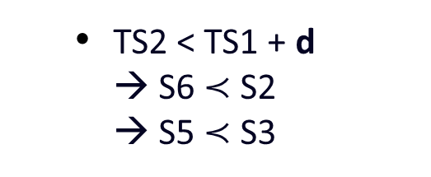
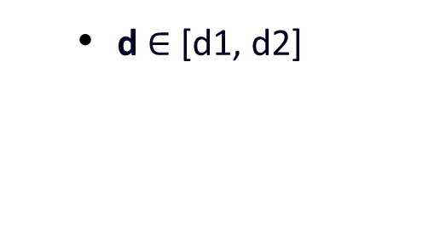
Comparing Local Clocks among cores
Thread 1
Thread 2
TS2 < TS1 + d → S6 $≺$ S2 → S5 $≺$ S3
TS_Core1
TS_Core2
(d = TS_Core2 – TS_Core1)
How to get the range:
Program Testing
Statistical Testing
S5: W2
S1: W1
But getting the precise value of d is very difficult.
TS2 - d
S6:TS2 ← RdLC;
wall time
S2:TS1 ← RdLC;
TS1 + d
d $∈$ [d1, d2]
S7: R2
S3: R1
Notes:
In this program, T1 is bound to Core1, and T2 is bound to Core2.
We assume d is the real difference value between these 2 cores.
TS1 and TS2 are the values of local clocks we got.
From them we know, if TS2 < TS1+d, S5 happens before S3.
Unfortunately , the hardware does not provide any way to get d value between cores.
In this case, we found that if we can get a range of d, the order of accesses can be known too.
Then there comes a new question? How to get the range of d?
In this paper, we proposes two methods: program testing and statistical testing.

Slide 20
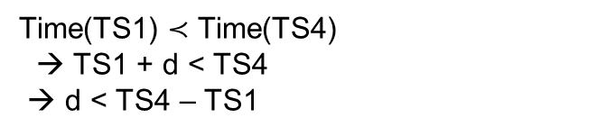
Scheme 1: Program Testing
X == 2
Thread 0
Thread 1
Thread 2
S1:TS1 ← RdLC;
S6:TS3 ← RdLC;
S2: X ← 1;
S7: X ← 2;
S3:TS2 ← RdLC;
S8:TS4 ← RdLC;
Join
Time(TS1) $≺$ Time(TS4)
→ TS1 + d < TS4
→ d < TS4 – TS1
Read X;
Notes:
Let me introduce program testing method first. We designed a small program for this purpose. This slide shows the small program.
Assume d is the difference value of these two cores.
When T0 read X, if it gets X==1. We can infer that S2 happens before S7, and therefore S1 happens before S8. This means the time represented by TS1 is earlier that the time represented by TS4, then we know TS1 + d < TS4, that is d < TS4-TS1
Similarly, if X==2, we know d > TS3 - TS2.

Slide 21
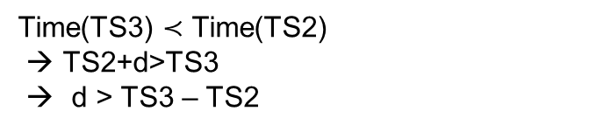

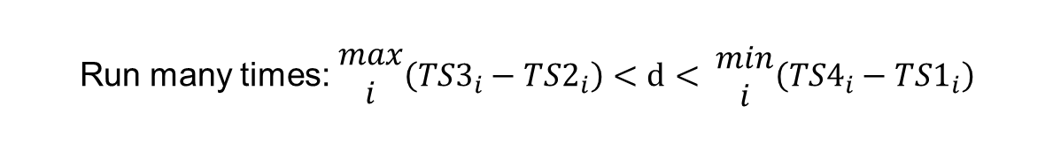
Scheme 1: Program Testing
X == 1
Thread 0
Thread 1
Thread 2
S1:TS1 ← RdLC;
S6:TS3 ← RdLC;
S2: X ← 1;
S7: X ← 2;
S3:TS2 ← RdLC;
S8:TS4 ← RdLC;
Join
Time(TS3) $≺$ Time(TS2)
→ TS2+d>TS3
→ d > TS3 – TS2
Read X;
$$\left({TS3}_{}−{TS2}_{}\right)<d< \left({TS4}_{}−{TS1}_{}\right)$$
Run many times: $\begin{matrix}max \\ i\end{matrix}\left({TS3}_{i}−{TS2}_{i}\right)<d< \begin{matrix}min \\ i\end{matrix}\left({TS4}_{i}−{TS1}_{i}\right)$
Notes:
If T0 gets X==1. We can infer that S7 happens before S2, and therefore S3 happens before S6.
So, we can get TS2+d>TS3, and then, d > TS3 – TS2
So, we can get the inequation $\left({TS3}_{}−{TS2}_{}\right)<d< \left({TS4}_{}−{TS1}_{}\right)$
If we run many times, we can get a region of d.

Slide 22
Scheme 2: Statistical Testing
If Thread 1 & Thread 2 read local clocks at the same time ➔ d = TS2 – TS1
This is WHAT WE WANT!
Thread 0
Thread 1
Thread 2
while(!flag);
while(!flag);
flag = 1;
TS1 ← RdLC;
TS2 ← RdLC;
Notes:
Let me introduce the other method to get the region of d. We named it statistical testing method.
We also designed a small program to do this job. This figure shows the program. It consist 3 threads. Thread 1 and 2 spin on a flag. Thread 0 set the flag. Then Thread1 and 2 read time stamp counter.
If the read operations of T1 and T2 happens at the same time, we can get d value easily. What we need to do is subtract TS1 from TS2.
However, this is just what we expect. T1 and T2 can not read at the same time.

Slide 23
Scheme 2: Statistical Testing
However, things are different in practice…
(1)Thread1 and Thread2 may not execute the same instruction when Thread0 sets “flag”.
(2)Cache coherence protocol will delay one thread
when two cores read the same invalid cache line, they will get the data serially
(3)Scheduling and Interruption may occur between while loop and RdLC
(4)ICache Miss or Page Fault may occur when thread exits the loop
with the help of kernel module
put while loop and RdLC in the same cache line
Notes:
There are 4 factors that make the two threads very difficulty to read the local clocks at the same time.
1.
2.
3.
4.

Slide 24
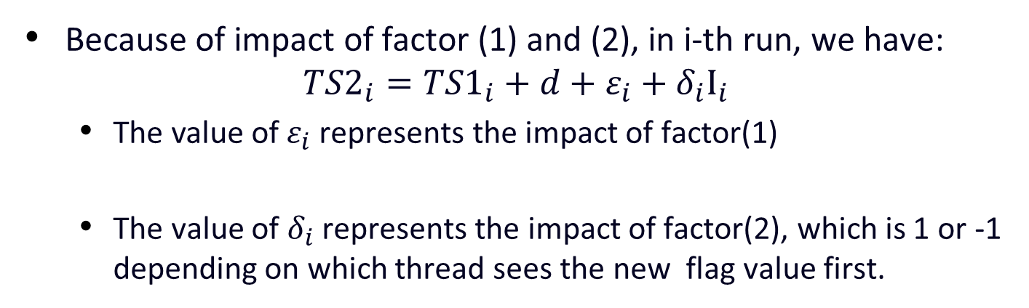
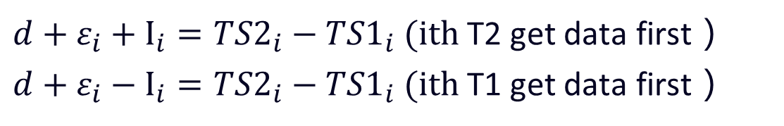
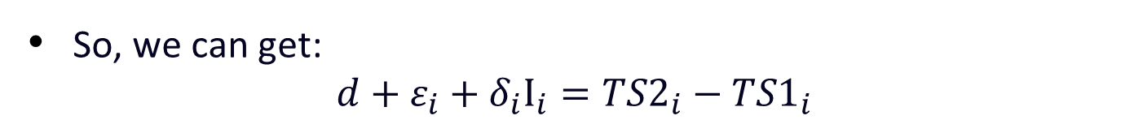
Scheme 2: Statistical Testing
Because of impact of factor (1) and (2), in i-th run, we have: ${TS2}_{i}={TS1}_{i}+d+ε_{i}+δ_{i}Ι_{i}$
$\text{The} \text{value} \text{of} ε_{i}$ represents the impact of factor(1)
The value of $δ_{i}$ represents the impact of factor(2), which is 1 or -1 depending on which thread sees the new flag value first.
So, we can get: $d+ε_{i}+δ_{i}Ι_{i}={TS2}_{i}−{TS1}_{i}$
$d+ε_{i}+Ι_{i}={TS2}_{i}−{TS1}_{i} (ith$ T2 get data first）
$d+ε_{i}−Ι_{i}={TS2}_{i}−{TS1}_{i} (ith$ T1 get data first）
Notes:
For factor1, when T0 writes to flag, which instruction that T1 or T2 is executing is random, each thread can get out of the while loop first.
And if the number of execution is large enough, the affection of this factor should be nearly 0.
For factor2, if we map threads to cores carefully, and under large number of executions, the affection of it should be the same of these two equations.

Slide 25
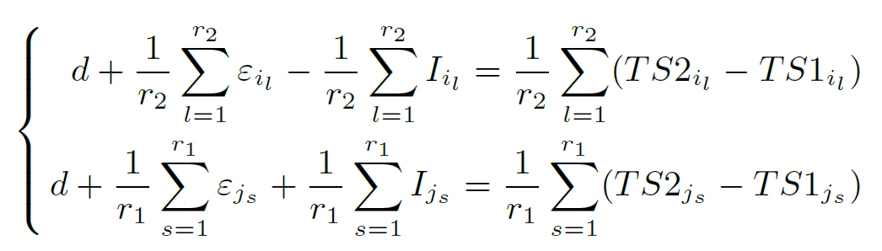

Scheme 2: Statistical Testing
$d+ε_{i}+Ι_{i}={TS2}_{i}−{TS1}_{i} (ith$ T2 get data first）
$d+ε_{i}−Ι_{i}={TS2}_{i}−{TS1}_{i} (ith$ T1 get data first）
Notes:
For factor1, when T0 writes to flag, which instruction that T1 or T2 is executing is random, each thread can get out of the while loop first.
And if the number of execution is large enough, the affection of this factor should be nearly 0.
For factor2, if we map threads to cores carefully, and under large number of executions, the affection of it should be the same of these two equations.

Slide 26
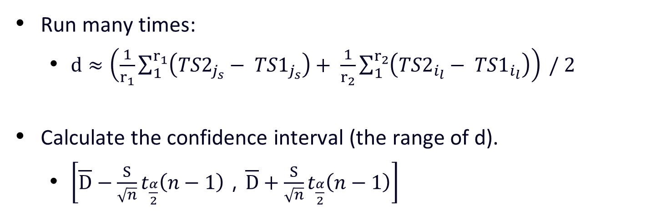
Scheme 2: Statistical Testing
Run many times:
$d≈\left(\frac{1}{r_{1}}\sum_{1}^{r_{1}}{\left({TS2}_{j_{s}}− {TS1}_{j_{s}}\right)}+ \frac{1}{r_{2}}\sum_{1}^{r_{2}}{\left({TS2}_{i_{l}}− {TS1}_{i_{l}}\right)}\right) / 2$
Calculate the confidence interval (the range of d).
$\left[\overline{D}−\frac{S}{\sqrt{n}}t_{\frac{α}{2}}\left(n−1\right)，\overline{D}+\frac{S}{\sqrt{n}}t_{\frac{α}{2}}\left(n−1\right)\right]$
Notes:
For factor1, when T0 writes to flag, which instruction that T1 or T2 is executing is random, each thread can get out of the while loop first.
And if the number of execution is large enough, the affection of this factor should be nearly 0.
For factor2, if we map threads to cores carefully, and under large number of executions, the affection of it should be the same of these two equations.

Slide 27
Determining the Order by Local Clocks
Out-Of-Order Execution Exclusion
Thread 1
Thread 2
W1
W1
W2
FENCE
?
FENCE
TS1 ← RdLC;
TS2 ← RdLC;
FENCE
FENCE
R2
R1
W3
Notes:
First to handle the OOO.
To these 2 threads, because the OOO, in fact the W1 may execute after TS1.
At this time, determine the order of these accesses by LC is wrong.
To handle such cases, an intuitive method is to add fences before and after RdLC instructions.
But can this solve this problem?

Slide 28
Determining the Order by Local Clocks
Write Operation:
Local Complete (LC), write to write buffer
Globally Visible (GV), write to cache
Solution (x86)
Thread 1
W1 (LC)
Thread 1
Thread 2
W1 (GV)
W1 (LC)
MFENCE
W2
FENCE
STORE
FENCE
LFENCE
TS1 ← RdLC;
X
TS2 ← RdLC;
RDTSC;
FENCE
FENCE
STORE TSC;
R2
LFENCE
W1 (GV)
R1
R1
W3
Notes:
In processors, the write operation can be divided into 2 phases, LC and GV.
Therefore the added FENCE instruction must assure that W1 is GV when RdLC is executed.
Otherwise in this situation, the W1(GV) executed after R2, this means that R2 happens before W1.
but according the TS1 and TS2 got from local clocks, from this we infer that W1 happens before R2.
Error occurs.
Then the added instructions must be considered carefully.
And this is the instruction sequence in x86, it satisfies that all R/W GV before RdLC, and RdLC is committed before the following R/W.

Slide 29
Determining the Order by Local Clocks
Explanation about the instrumented instructions to record clock.
Solution (x86)
Thread 1
W1 (LC)
W1 (GV)
MFENCE
It will hold loads and stores until all preceding loads and stores become globally visible
STORE
LFENCE
RDTSC;
It will hold all instructions (not just loads and stores as in MFENCE) until all preceding instructions are locally complete.
STORE TSC;
LFENCE
R1
Notes:
In processors, the write operation can be divided into 2 phases, LC and GV.
Therefore the added FENCE instruction must assure that W1 is GV when RdLC is executed.
Otherwise in this situation, the W1(GV) executed after R2, this means that R2 happens before W1.
but according the TS1 and TS2 got from local clocks, from this we infer that W1 happens before R2.
Error occurs.
Then the added instructions must be considered carefully.
And this is the instruction sequence in x86, it satisfies that all R/W GV before RdLC, and RdLC is committed before the following R/W.

Slide 30
Determining the Order by Local Clocks
Explanation about the instrumented instructions to record clock.
Solution (x86)
Thread 1
Because RDTSC is not a regular memory access operation, MFENCE cannot guarantee that W1(GV) happens-before RDTSC.
Notice that the FENCE instructions can incur very high overhead!
To eliminate the use of FENCE instructions, we could instead use the Compare-And-Swap (CAS) instruction and the processor-specific memory consistency model to perform the optimization.
W1 (LC)
W1 (GV)
Reason
MFENCE
STORE
It is any store instruction that has no data dependence with other instructions.
Happen-before
LFENCE
It will read the local clock into %edx:%eax
RDTSC;
STORE TSC;
It will store the value of %edx:%eax into memory
LFENCE
R1
Notes:
In processors, the write operation can be divided into 2 phases, LC and GV.
Therefore the added FENCE instruction must assure that W1 is GV when RdLC is executed.
Otherwise in this situation, the W1(GV) executed after R2, this means that R2 happens before W1.
but according the TS1 and TS2 got from local clocks, from this we infer that W1 happens before R2.
Error occurs.
Then the added instructions must be considered carefully.
And this is the instruction sequence in x86, it satisfies that all R/W GV before RdLC, and RdLC is committed before the following R/W.

Slide 31
Optimizations
Using CAS and TSO to optimize the instrumented instructions.
Thread 1
W1 (LC)
It is executed atomically during which the bus and the cache are locked until its completion. Before its execution, W₁ is globally visible.
W1 (GV)
LOCK CMPXCHG
Happen-before
LFENCE
x86 adopts a weaker Total Store Order model:
It guarantee the order of Read->Write,
Read->Read, Write->Write.
But it did not guarantee the order of
Write->Read if they access different locations.
So, we place READ TSC here!
RDTSC;
STORE TSC;
READ TSC;
R1

Slide 32
Optimizations
Using CAS,TSO and RDTSCP to optimize the instrumented instructions.
Thread 1
W1 (LC)
It could read the local clock value with the serial number of the logical core.
It waits for all previous instructions to be completed locally before reading the local clock value.
But It cannot guarantee the preceding instructions are scheduled before it.
W1 (GV)
LOCK CMPXCHG
Happen-before
RDTSCP;
STORE TSC;
READ TSC;
R1

Slide 33
Handling Overflow of Local Clocks
(Local Clock Overflow…)
TS₁
TS₂
TS₃
TS₄
……
……
……
……
TS_{n-1}
TS_{n}
Time (T_{i+1} – T_{i}) < Time(Overflow)
If T_{i+1} – T_{i} < 0 ➔ Overflow
If T_{i+1} – T_{i} > 0 ➔ Not Overflow
Add an overflow counter during offline analysis
Notes:
The local clocks overflow at a certain frequency, and may bring error to our bug reproduction.
The we use the following method to handle local clock overflow.
Make sure the time between 2 records of local clock is less that period of overflow.
Then by calculating the difference of 2 continuous records, we can know whether the local clock overflow between these 2 records.
3. And then we can add a overflow counter during offline analysis.

Slide 34
Experiments
We implemented two systems according to PRES [Park et al, 2009] and CLAP [Huang et al, 2013], called:
PRES-impl and CLAP-impl
Our approach is applied to them, and called:
PRES-tc, records local clock values instead of global order
CLAP-tc, additionally records local clock values
Platform and benchmarks:
TYPE | BENCHMARKS | DESCRIPTION | BUG TYPES
Server | Apache HTTPD | Web Server | AV
 | Cherokee | Web Server | AV
Desktop Application | PBzip2 | Compressor | OV
 | Pfscan | File Scanner | AV
 | aget | HTTP/FTP Downloader | AV
Scientific Application | Barnes | Barnes N-Body algorithm | OV
 | LU | LU matrix multiplication | OV
 | Radiosity | Graphics rendering | OV
Mini Case | Racey | Race Test Case | -
CPU | Intel Xeon E7-4807, 6 cores, 1.87GHz
Processors | 4
Level 1 Cache (I/D) | 6 * 24K / 6 * 24K
Level 2 Cache | 6 * 256K
Level 3 Cache | 18M
Memory | 16G
OS | Linux 2.6.32
Compiler | GCC 4.6.0
SMT Solver | Z3
Notes:
Then we apply our method to 2 bug reproducing systems PRES and CLAP.
In PRES, at each record point, we record the value of local clocks additionaly.
In CLAP, we use the time information got values of local clocks to accelerate the SMT solving of it.
Introduce platform and benchmarks…

Slide 35
PRES, recording overhead:
PRES, reproducing tries
reduced by 1% ~ 85%
Benchmark | RW |  |  | BB |  |  | FUNC |  |  | SYNC
 | impl | tc (S/P) |  | impl | tc (S/P) |  | impl | tc (S/P) |  | impl | tc (S/P)
 | Tries | Add_UO | Tries | Tries | Add_UO | Tries | Tries | Add_UO | Tries | Tries | Add_UO | Tries
APACHE | 1 | 0.05%/0.09% | 1/1 | 1 | 0.02%/0.03% | 1/1 | 5 | 0.01%/0.01% | 5/5 | 69 | 0.00%/0.00% | 69/69
CHEROKEE | 1 | 0.02%/0.03% | 1/1 | 8 | 0.00%/0.00% | 8/8 | 21 | 0.00%/0.00% | 21/21 | 46 | 0.00%/0.00% | 46/46
PBzip2 | 1 | 0.00%/0.00% | 1/1 | 2 | 0.00%/0.00% | 2/2 | 3 | 0.00%/0.00% | 3/3 | 3 | 0.00%/0.00% | 3/3
PFSCAN | 1 | 2.94%/4.42% | 1/1 | 1 | 0.05%/0.07% | 1/1 | 11 | 0.00%/0.00% | 11/11 | 32 | 0.00%/0.00% | 32/32
AGET | 1 | 0.00%/0.00% | 1/1 | 1 | 0.00%/0.00% | 3/3 | 9 | 0.00%/0.00% | 9/9 | 14 | 0.00%/0.00% | 14/14
BARNES | 1 | 0.24%/0.36% | 1/1 | 1 | 0.00%/0.00% | 1/1 | 4 | 0.00%/0.00% | 4/4 | 12 | 0.00%/0.00% | 12/12
LU | 1 | 19.35%/25.50% | 1/1 | 1 | 0.07%/0.09% | 1/1 | 6 | 0.00%/0.00% | 6/6 | 3 | 0.00%/0.00% | 10/10
RADIOSITY | 1 | 3.10%/4.88% | 1/1 | 1 | 0.02%/0.03% | 1/1 | 98 | 0.00%/0.00% | 98 | -/- | 0.00%/0.00% | -/-
no more tries needed
Notes:
For PRES, runtime overhead is reduced by XXX.
And during bug reproduction, no more tries needed.

Slide 36
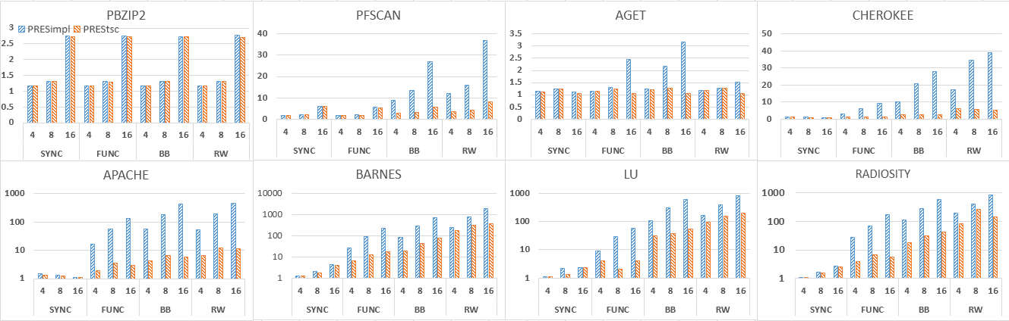
PRES, scalability
More threads
PRES-tc still can record concurrently.
PRES-impl suffers more slowdown.
Notes:
If there are more threads, PRES-tc still can record concurrently, while there may be more competition in PRES-impl.
And therefore, higher percentage of runtime overhead is reduced.

Slide 37
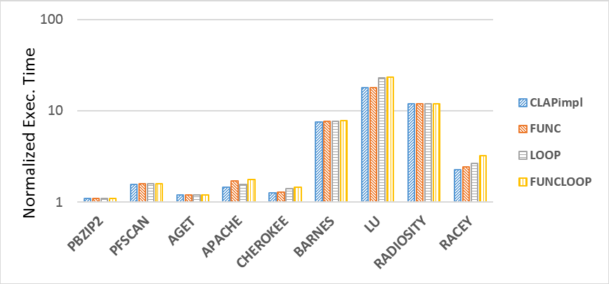
CLAP, recording overhead
comparing to CLAP-impl, the overhead of CLAP-tc is 1%~42%
less that 10% in most cases.
Notes:
For CLAP, we record more data online, and bring a little more overhead.
Comparing to CLAP-impl, the overhead of XXX…
And the extra overhead is small.

Slide 38
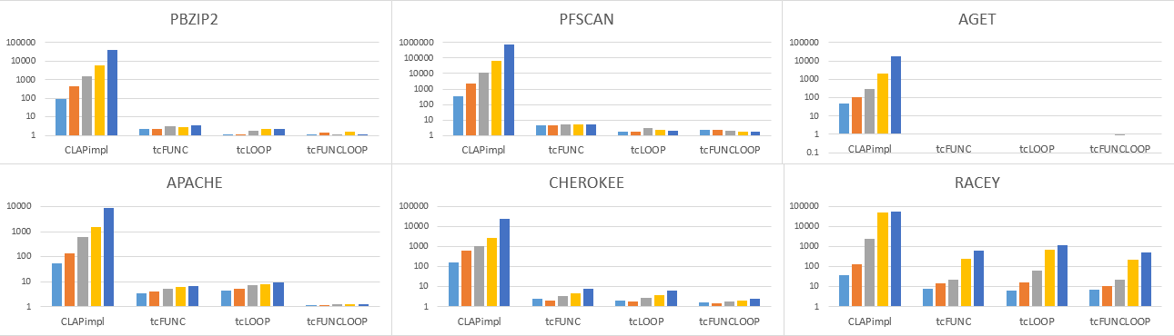
CLAP, solving time
normalized execution time to NOST (Near-Optimal Solving Time)
84.66% ~ 99.99% solving time are reduced
solving time of CLAP-tc is less than 10X of NOST, for most cases.
Notes:
While during offline analysis phase, there is a great progress.
Each benchmark we have 5 different inputs , from small to large.
And the baseline is NOST, explain…..
This figure show that, comparing to CLAP-impl, XXXX are reduced.
Further more, for most cases, the solving of CLAP-tc is less than XXXX….

Slide 39
Difference values of Local Clocks among Cores
Results of Program Testing
4 different implementations
To get a smaller range, we can run all test implementations as many times as possible
Testing Program | 1st |  | 2nd
 | MIN | MAX | MIN | MAX
(a) | -114 | 112 | -116 | 120
(b) | -190 | 182 | -180 | 188
(c) | -128 | 128 | -124 | 126
(d) | -116 | 120 | -120 | 110
Result | -114 | 112 | -116 | 110
Notes:
Then, we show the results of calculated difference values of local clocks among cores.
To program testing, we design 4 different implementation of testing program, which shows in the paper.
Each of them can get a different range, we can combine them to get a smaller range.
From the table, we can see that the range is about 200 cycles. Although it is not very large, but it is much larger that the real value of the difference value of local clocks.

Slide 40
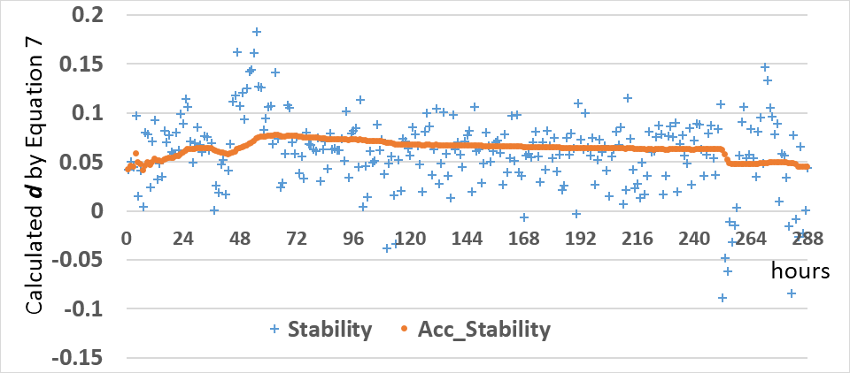
Result of Statistical Testing
Stability, d is calculated every 10000 runs
more than 10 days are spent in collecting these data
Notes:
For statistical testing, the d calculated by our formula should be stable.
In this figure, we collect these data for more than 10 days.
Stability means that the value of d is calculated by data collected every hour.
And Acc_Stability means that d is calculated by data collected from begnning.
From it , we can see that during a long period, the d calculated by our formula is very stable.

Slide 41
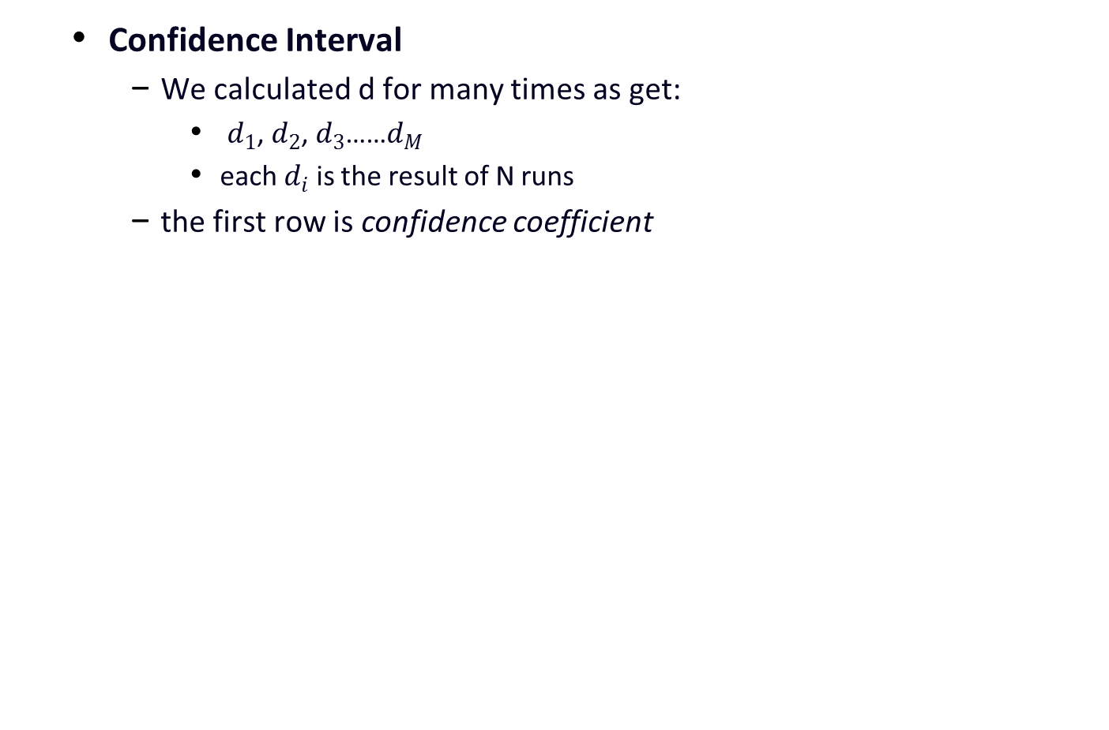
Confidence Interval
We calculated d for many times as get:
$d_{1}$, $d_{2}$, $d_{3}$……$d_{M}$
each $d_{i}$ is the result of N runs
the first row is confidence coefficient
N | 20 |  |  | 50
M | 5 | 10 | 20 | 5 | 10 | 20
0.99 | [-5.86, 9.39] | [-1.69, 3.66] | [-0.63, 1.75] | [-1.48, 1.88] | [-0.41, 1.08] | [-0.25, 0.58]
0.999 | [-12.50, 16.03] | [-2.95, 4.92] | [-1.05, 2.17] | [-2.93, 3.34] | [-0.77, 1.43] | [-0.40, 0.73]
0.9999 | [-23.98, 27.51] | [-4.45, 6.42] | [-1.47, 2.59] | [-5.46, 5.86] | [-1.18, 1.85] | [-0.55, 0.88]
0.99999 | [-44.23, 47.77] | [-6.29, 8.26] | [-1.91, 3.03] | [-9.91, 10.31] | [-1.70, 2.36] | [-0.70, 1.03]
Notes:
This table shows the range calculated by statistical testing.
From it we can see if we collect more data , and we can get a smaller range.

Slide 42
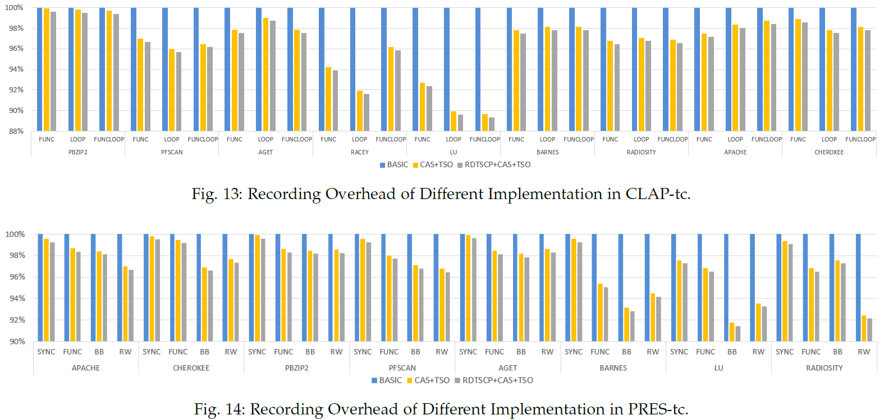
Evaluating the optimization effectiveness of recording local clock.

Slide 43
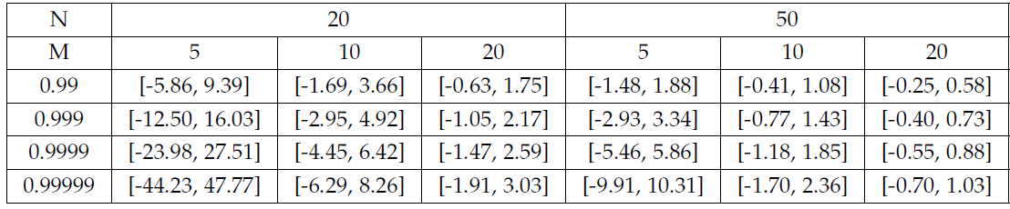
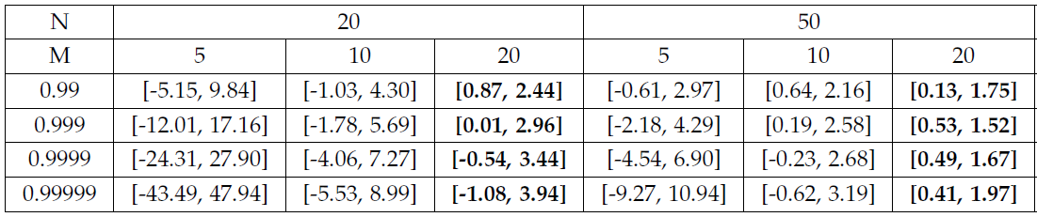
Detecting the Modification of Local Clocks
We modify the IA32_TSC_ADJUST MSR to speed up 1 clock on a logical core.
Before Modifying the Local Clock:
Using the Statistic Testing Scheme is quite sufficient to detect such small modification of local clocks during record-and-replay.
After Modifying the Local Clock:

Slide 44
Conclusion
Concurrency Bug Reproduction
online recording overhead
offline analysis overhead
Using local clocks, both of them can be reduced
compare local clocks among different cores
determine the precise clock value when each thread accesses shared resources
handle the possible overflow of local clocks
Efficiency
PRES, reduce 1% ~ 85% runtime overhead
CLAP, reduce 84.66% ~ 99.99% solving time

Slide 45

Thank you!

Slide 46
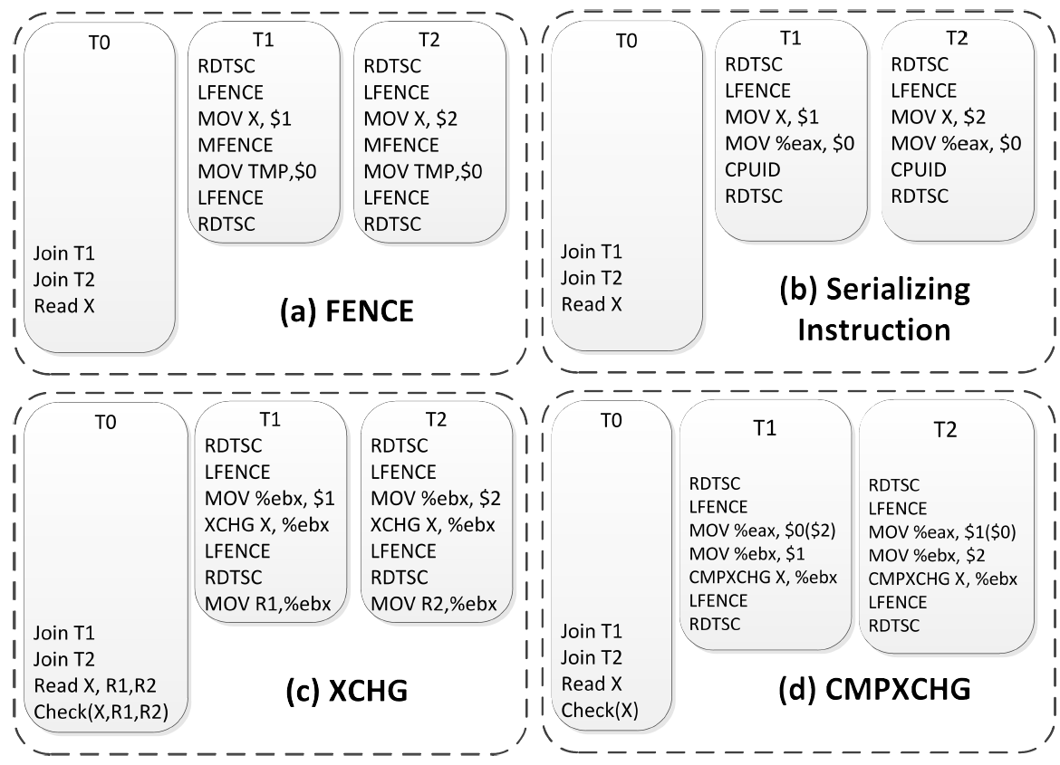
4 implementations on Program Testing

Slide 47
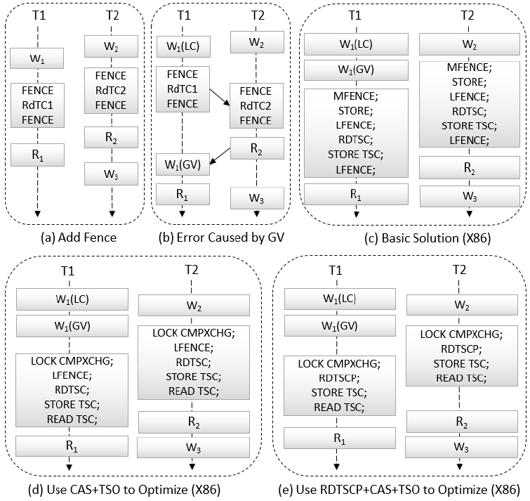
Instructions to record the local clock

Slide 48
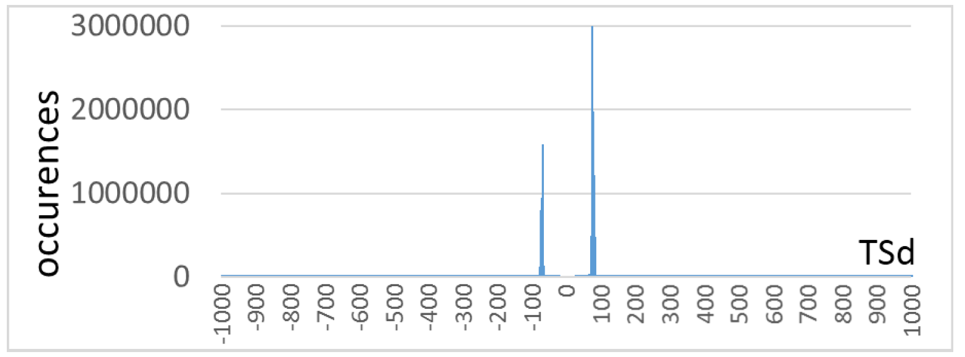
A Distribution of TSd

